Slide 1

GOVERNMENT POLYTECHNIC NAGPUR (An Autonomous Institute of Government of Maharashtra)
Presentation on
On Campus Internship
Name Of Project : Bicycle's Odometer Comes Speedometer
Team Members :
1. Nitesh Lilhare (1904032)
2. Vedant Golait (1904018)
3. Atharva Liloriya (1904033)

Slide 2
Introduction
1. A speedometer or speed meter is a measures and displays the instantaneous speed of a vehicle.
2. Now universally fitted to motor vehicles, they started to be available as options in the early 20th century, and as standard equipment from about 1910 onwards.
3. The circuit uses an in Arduino Uno, 16*2 LCD display and Hall Effect Sensor and some other components.

Slide 3
Defination
Odometer: An odometer is an instrument used for measuring the distance trivaled by a vehicle. The device may be electronic, mechanical, or a combination of the two.
Speedometer: A speedometer or speed meter is that measures and displays the instantaneous speed of a vehicle.

Slide 4
INFORMATION
1. The Arduino Uno is an open-source microcontroller board based on the Microchip Atmega328P microcontroller and developed by Arduino.cc.
2. The board is equipped with sets of digital and analog input/output pins that may be interfaced to various expansion boards and other circuits.

Slide 5
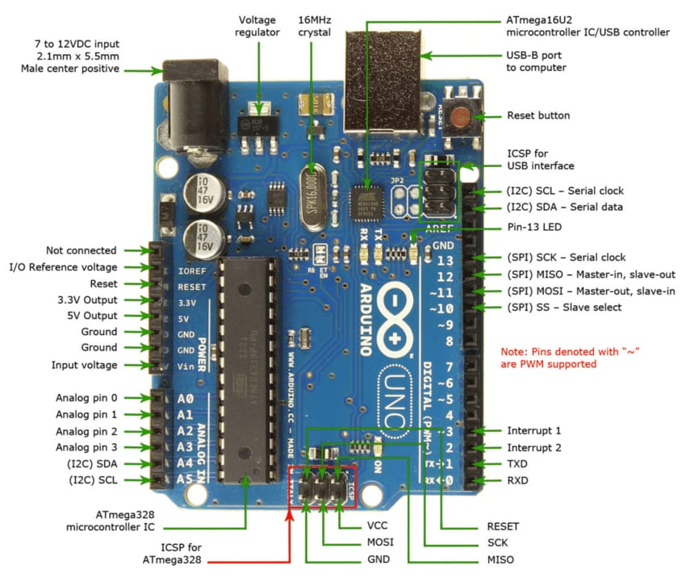
Arduino

Slide 6
SPECIAL PIN FUNCTION
1. Serial / UART: pins 0 (RX) and 1 (TX), Used to receive (RX) and transmit (TX) TTL serial data.
2. External interrupts: pins 2 and 3, These pins can be configured to trigger an interrupt on a low value, a rising or falling edge, or a change in value.
3. PWM (pulse-width modulation): pins 3, 5, 6, 9, 10, and 11. Can provide 8-bit PWM output with the AnalogWrite() function.
4. SPI (Serial Peripheral Interface): These pins support SPI communication using the SPI library.
5. TWI (two-wire interface): Support TWI communication using the Wire library.
6. AREF (analog reference): Reference voltage for the analog inputs

Slide 7
Adafruit RGB (16×2) Lcd display
1. This is a fancy upgrade to standard 16x2 LCDs, instead of just having blue and white, or red and black, this LCD has black characters on a full color RGB-backlight background.
2. The LCD has resistors on board already so that you can drive it with 5V logic and the current draw will be ~20mA per LED.

Slide 8
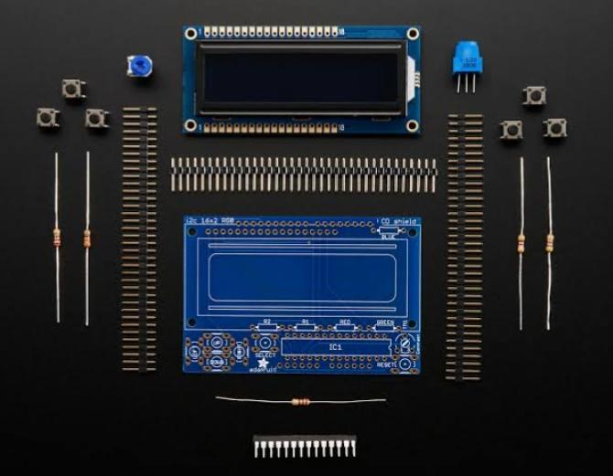
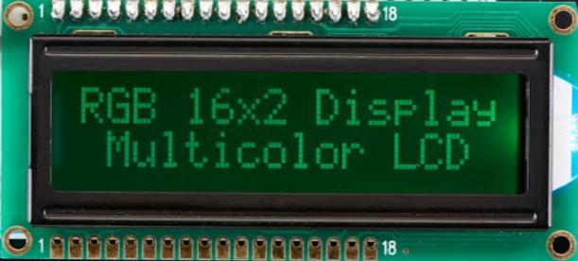
Adafruit RGB (16×2) LCD display

Slide 9
Information:
What is potentiometer :-
A potentiometer is a three-terminal device with a sliding or rotating contact that forms an adjustable Resistance.

Slide 10
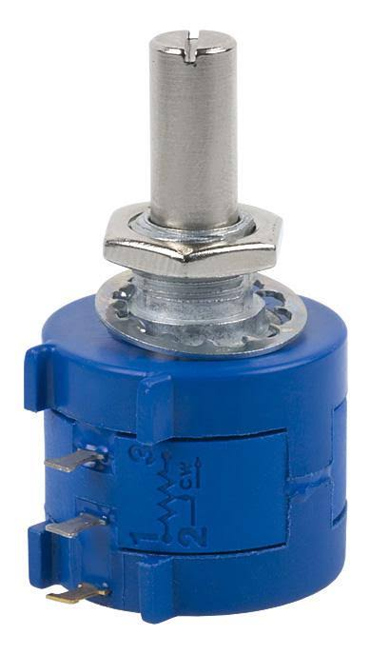
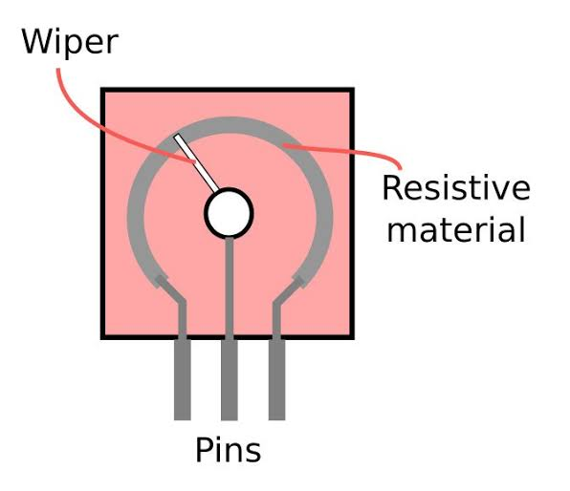
Potentiometer
Internal construction
1
3
2

Slide 11
Specification
Manufacturer Part No :- 3362P-1-103LF
Manufacturer :- BOURNS
Element Material :- cermet
Trimpot Type :- single Turn
Track Resistance :- 10kohm
Power Rting :- 500mW
Tolerance :- ± 10%......(silver)

Slide 12
Introduction of hall effect sensor
A Hall effect sensor (or simply Hall sensor) is a type of sensor which detects the presence and magnitude of a magnetic field using the Hall effect. The output voltage of a Hall sensor is directly proportional to the strength of the field. It is named for the American physicist Edwin Hall.

Slide 13
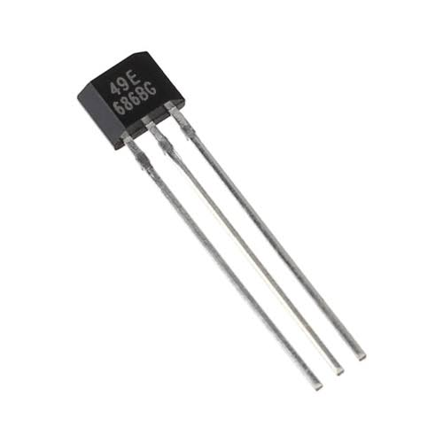
Hall effect sensor

Slide 14
Features
Hall Effect Sensor: On-chip Hall plates 360° Output 1° Resolution, calculated on chip Detect movement and the direction of movement Relative rotation angle Raw data: can be used to calculate degrees on external processor Wide operational range No external components required

Slide 15
APPLICATION
Hall Effect sensors are used for detecting and measuring proximity, position, and speed, through their ability to sense magnetic fields. As non-contact sensors, they are useful for measuring AC and DC current.

Slide 16
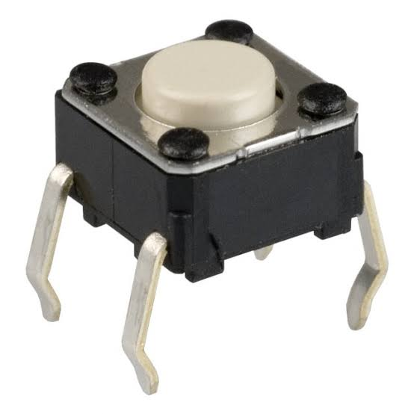
Push button switch
The Omron B3F series are tactile switches.
These switches are available in
6mm × 6mm, 12mm × 12mm sizes with different models
such as standard,
side operated, long durability,
high force and high reliability gold plated etc.

Slide 17
Working principles
A push button switch is a small, sealed mechanism that completes
an electric circuit when you press on it. When it’s on, a small metal
spring inside makes contact with two wires, allowing electricity to
flow. When it’s off, the spring retracts, contact is interrupted, and
current won’t flow.

Slide 18
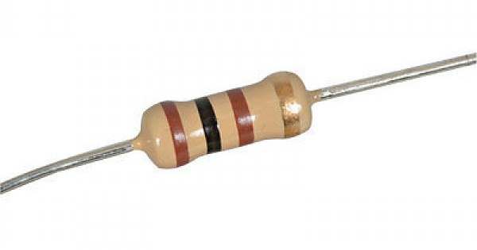
Resistor
The product is Speedometer. One of the component used in this is a resistor. It’s Manufacturer Name is VISHAY. Its manufacturer Part No. Is CMF50221R00FHEB. The Resistance of resistor is 221ohm [CFR]. The power consumption of this resistor is 250mW. Its tolerance is very less that is [+- 1%] Its voltage rating is Upto 200V. The metal used for coating is made from Metal Film Axial Leaded.

Slide 19
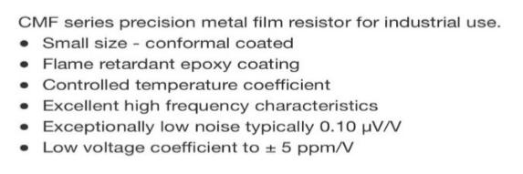
Product overview and Featured

Slide 20
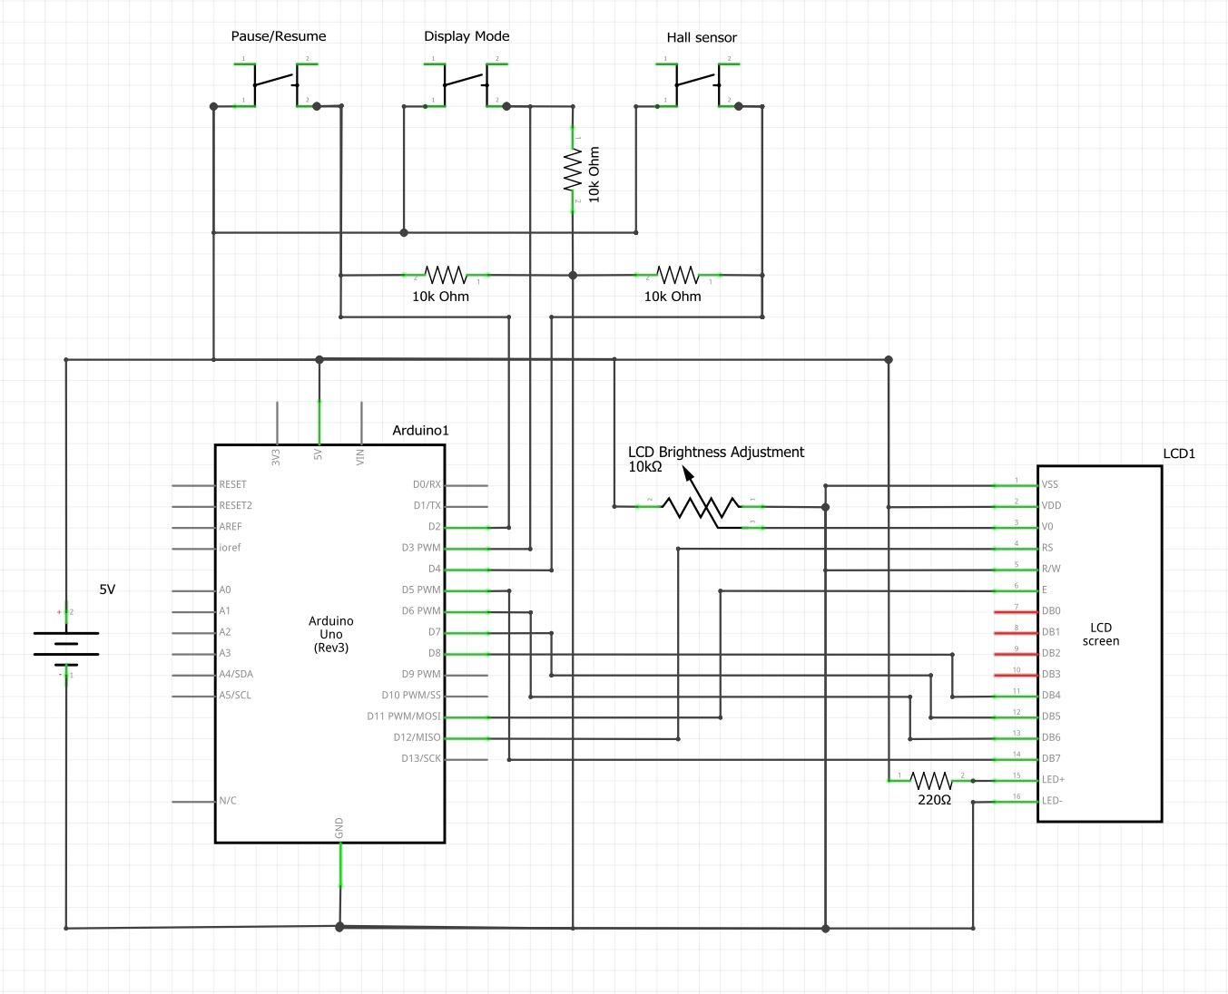
Circuit diagram

Slide 21
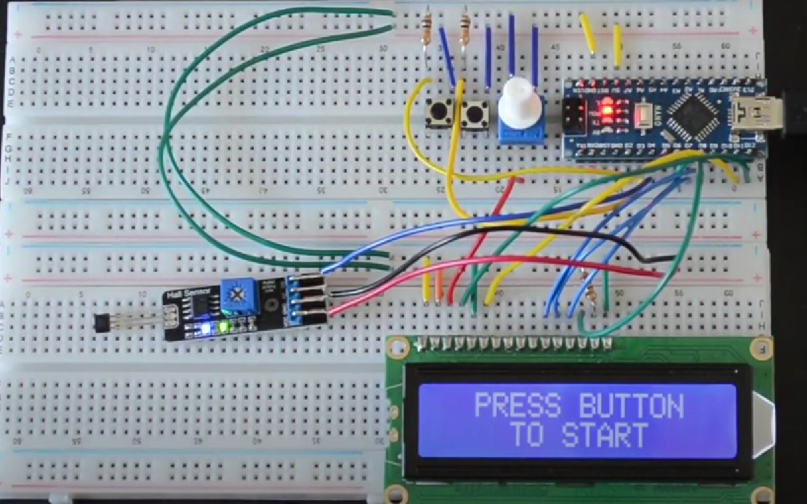
Working
1. When the Arduino is initially powered on or reset,
a "PRESS BUTTON TO START" message will appear
on the 16 x 2 LCD screen.
2. Pressing either the Pause, Resume or Display Mode
button will start the 1st lap. A "CYCLE SAFELY!"
message will initially appear for a 2 second period
during which recording is already ongoing.

Slide 22
Working
3. The display will then show the kilometers traveled,
km/hr. and average km/hr for lap/period
(to the right of "A" on 2nd line, A=Average).
This is updated in real-time.
4. Pressing the Display Mode button when in pause mode will
cycle through the different laps recorded. The first press will
show the grand totals for all laps
(with a “T” shown in upper-left-hand corner of the display),
Depending on how many laps you recorded.

Slide 23
Working
5. If the Pause/Resume button is pressed again while
the “CYCLE SAFELY!” message appears
(so during initial 2 seconds of new lap), no lap data
will be recorded and the device will be put back into
pause mode showing the data for the last lap traveled.
6.. Only data for 99 laps/periods can be recorded.
Once the 99th lap is recorded, any additional laps will be
recorded into the slot for the 99th lap thus overriding the
previous data stored.

Slide 24
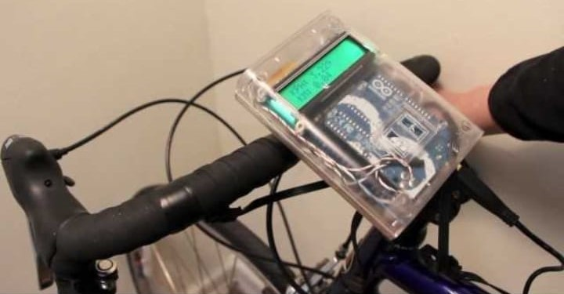
Features
Digital read out.
Speed display in km/hr.
Distance Trivel display in km.
Reliability but to use of Arduino Uno.
Home- breWed Speed transducer Or sensor
Self reset To zero after Completon Of 99999.9 km.
Easy to duild And fixed on the bike.

Slide 25
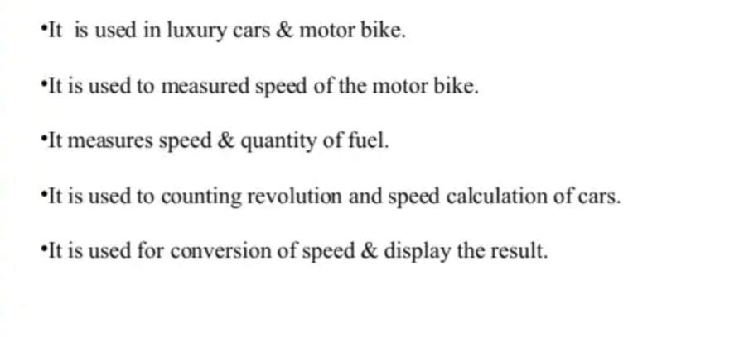
Application

Slide 26
Conclusion
When competition of this project we learn some new things about on-campus internship.
And main think is that concept about Arduino and Hall effect sensor get cleared.
And also our group guide and group members give a lots of hard work, for doing this project.

Slide 27
-: thank you :-

